Slide 1
Big Mountain Resort - Recommendations based off random forest pricing model
Notes:
Problem identification (1-2 slides)
Recommendation and key findings (1 slide)
Modeling results and analysis (3-4 slides)
Summary and conclusion (1 slide)

Slide 2
Problem Identification
Big Mountain Resort’s pricing strategy currently
Charge premium above average resorts in market segment
Does not take into account how much facilities
Additional chair increases operation costs by $1,540,000
Need to change pricing strategy
To cut costs
To make more data-driven business decisions
Notes:
Problem identification (1-2 slides)
Recommendation and key findings (1 slide)
Modeling results and analysis (3-4 slides)
Summary and conclusion (1 slide)

Slide 3
Recommendation and key findings
Recommendation - Increase Big Mountain Resort vertical drop by adding a run to a point 150 lower down but requiring the installation of an additional chair lift to bring skiers back up, without additional snow making coverage
Results - Increases support for ticket price by $1.99, amounting to $3,474,638 over the season
The four most dominant parameters to change pricing are fastQuads, Runs, Snow Making_ac, and vertical_drop.
In the feature, making changes to these facilities will affect the price the most, compared to other facilities/features
Notes:
Problem identification (1-2 slides)
Recommendation and key findings (1 slide)
Modeling results and analysis (3-4 slides)
Summary and conclusion (1 slide)

Slide 4
Modeling results and analysis - Step 1: Data Wrangling
Wrangled data provided - loaded and explored data
Looked for missing data
Confirmed unique data entries
Explored relationships of resorts between region and states, as well as distribution of ticket prices by state
Plotted histograms of numeric data features
This allowed us to easily see if some features look concerning, and spot check data
Cleaned out data entries that did not have price data
Realized that population data would be useful, and obtained it from wikipedia
Determined that adult weekend price as our main focus, as weekday price had less data
Notes:
Problem identification (1-2 slides)
Recommendation and key findings (1 slide)
Modeling results and analysis (3-4 slides)
Summary and conclusion (1 slide)

Slide 5
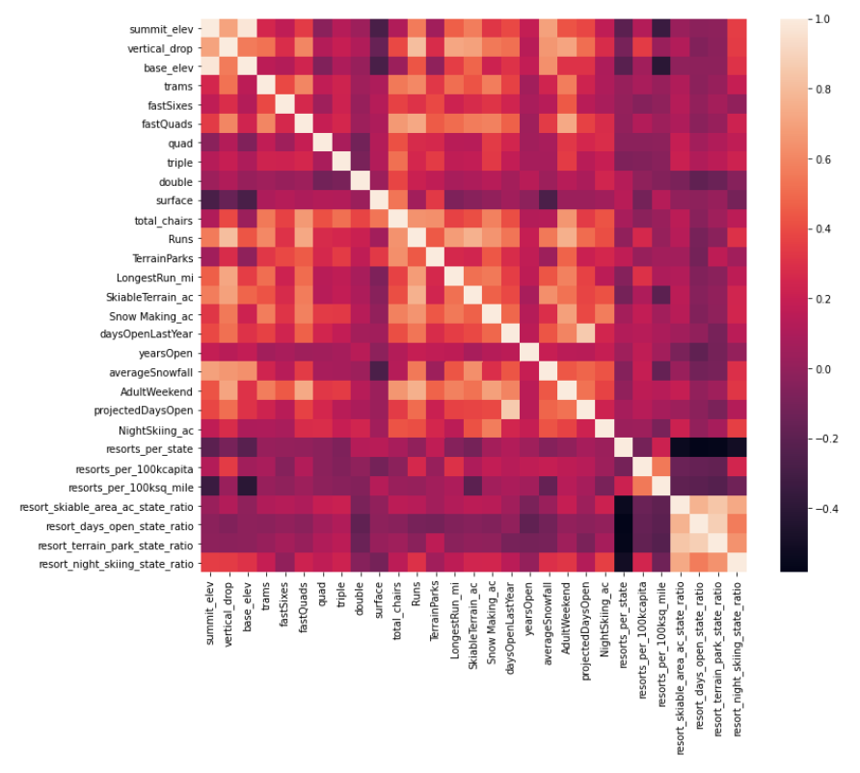
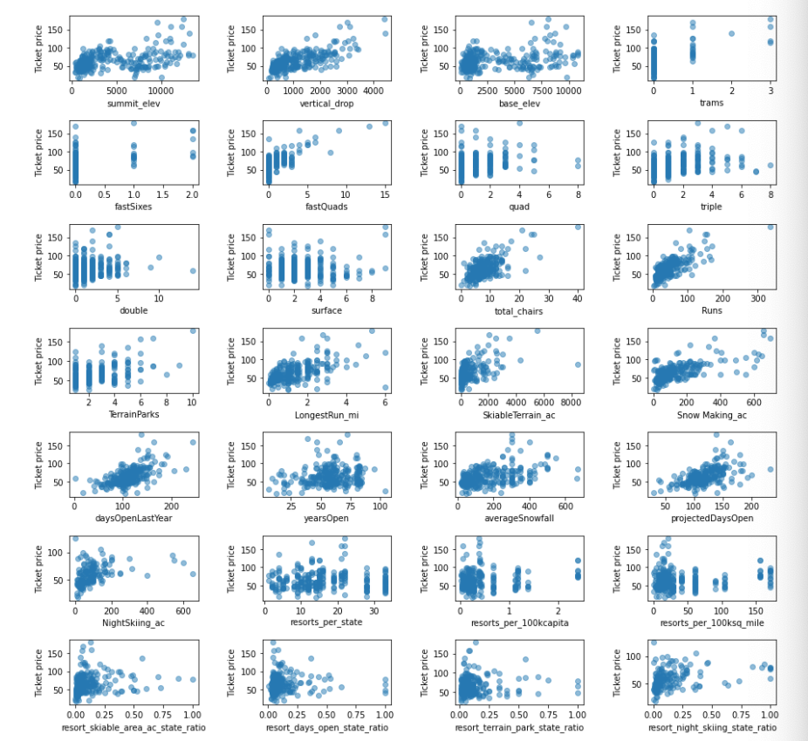
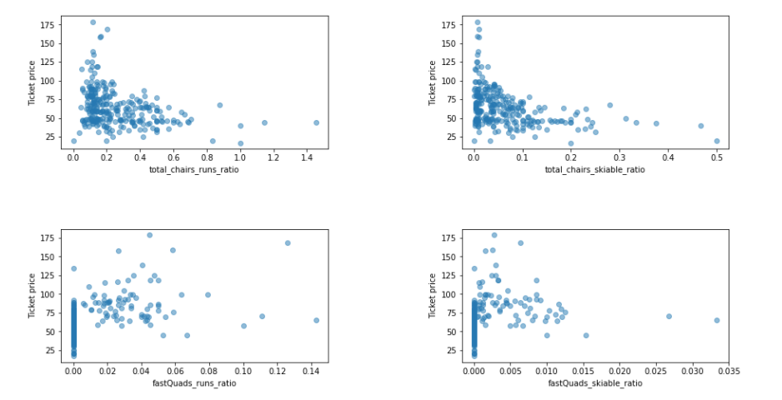
Modeling results and analysis - Step 2: Exploratory Data Analysis
Using a heatmap, we were able to see that AdultWeekend ticket price had a high correlation with fastQuads, Runs, and Snow making, letting us know that visitors place a lot of value in facilities and how guaranteed snow, over other features such as terrain area.
Several noteworthy patterns include the positive correlation between vertical drop, fast quads, runs, total chairs and price.
We also explored the ratio of chairs to the number of runs and area of skiable terrain against price to see how the number of facilities has an effect on price.
In this step, we noted that we should be wary of data and whether it is exclusive vs. mass market resort effect. We also realized that we need to keep in mind that a high price might not always equate to high profit, because the price per visitor may be high but number of visitors may be low.
Notes:
Problem identification (1-2 slides)
Recommendation and key findings (1 slide)
Modeling results and analysis (3-4 slides)
Summary and conclusion (1 slide)

Slide 6
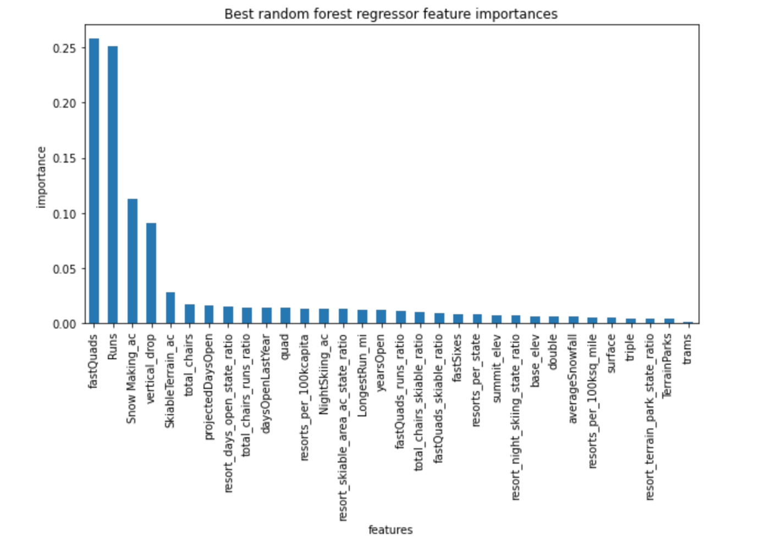
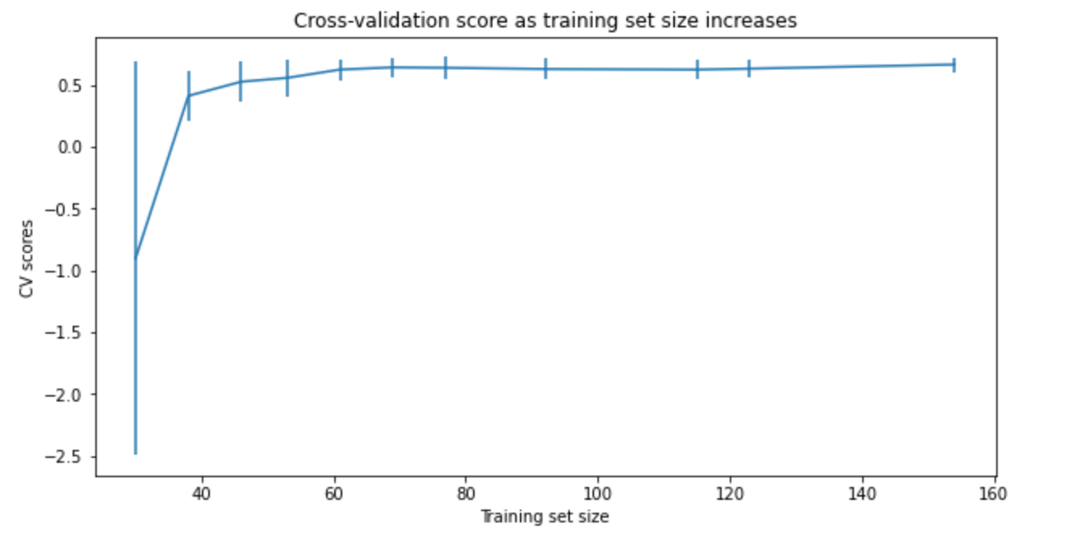
Modeling results and analysis - Step 3: Pre-Processing and Training Data
We started to build machine learning models
First attempt used mean value as predictor
Second attempt used median value as predictor
using median as predictor gave a much smaller Mean Absolute Error and root Mean Squared Error
Decided to use median value as predictor, because of smaller MAE and MSE
Built two models
Best linear regression model - cross validation mean absolute error of 10.50
Best random forest model - cross validation mean absolute error of 9.64
Decided to use random forest model, because of lower cross validation MAE
Model showed that the dominant top 4 features in data given are fastQuads, Runs, Snow Making_ac, and vertical_drop
Used cross-validation to confirm whether data set size was large enough
Concluded it was
Notes:
Problem identification (1-2 slides)
Recommendation and key findings (1 slide)
Modeling results and analysis (3-4 slides)
Summary and conclusion (1 slide)

Slide 7
Modeling results and analysis - Step 4: Modeling
Used best random forest model to gain insight into what Big Mountain's ideal ticket price could/should be, and how that might change under various scenarios
Using pricing model, expected ski ticket is $95.87, much greater than the current price of $81.00.
To account for the new chair lift cost, ticket prices must be raised
Explored 4 different scenarios for future improvements
Permanently closing down up to 10 of the least used runs. This doesn't impact any other resort statistics.
The model says closing one run makes no difference. Closing 2 and 3 successively reduces support for ticket price and so revenue. If Big Mountain closes down 3 runs, it seems they may as well close down 4 or 5 as there's no further loss in ticket price. Increasing the closures down to 6 or more leads to a large drop.
Increase the vertical drop by adding a run to a point 150 feet lower down but requiring the installation of an additional chair lift to bring skiers back up, without additional snow making coverage
This scenario is expected to increase support for the ticket price by $1.99, and over the season, this could be expected to amount to $3,474,638.
Same as number 2, but adding 2 acres of snow making cover
Same result as second scenario - such a small increase in snow making area makes no difference
Increase the longest run by 0.2 mile to boast 3.5 miles length, requiring an additional snow making coverage of 4 acres
No difference - longest run feature is not one of the four most important features in the random forest model
Notes:
Problem identification (1-2 slides)
Recommendation and key findings (1 slide)
Modeling results and analysis (3-4 slides)
Summary and conclusion (1 slide)

Slide 8
Summary and Conclusion
Out of the 4 scenarios, the 2nd scenario was the best option
This scenario is expected to increase support for the ticket price by $1.99, and over the season, this could be expected to amount to $3,474,638.
Our pricing model showed that the dominant top 4 features in data given are fastQuads, Runs, Snow Making_ac, and vertical_drop
When making decisions about future business improvements, note that these features matter the most to visitors
This will allow you to make more knowledgeable future investments - change Big Mountain Resort’s pricing strategy based off this pricing model
Use pricing model and change parameters to see how different business improvements will affect price and therefore revenue
Notes:
Problem identification (1-2 slides)
Recommendation and key findings (1 slide)
Modeling results and analysis (3-4 slides)
Summary and conclusion (1 slide)

